Slide 1
British Airways Web Scraping and Sentiment Analysis on Customer Reviews Presented by: - Revanth Nagaraj Mallol

Slide 2
Task 1: Web scraping to gain company insights
Project Objective
State the goal: Analyze British Airways reviews from Skytrax to provide insights on customer sentiment and service performance.
Overview of web scraping and sentiment analysis methods.
Briefly describe tools used: Python, BeautifulSoup, Requests.
Screenshot of the Skytrax website and sample review data.
Code snippet (if desired, or an example of the scraped data structure).

Slide 3
Web Scraping with BeautifulSoup
Request library:- Retrieves HTML content from the Skytrax webpage using the specified URL.
BeautifulSoup:- Parses the HTML content to make it easier to navigate.
Loop through reviews:- Finds all elements containing the review text(e.g., div with class text_content).
The loop extracts each review and appends it to a list for further analysis.

Slide 4
Data Collection, Cleaning and Data Analysis Techniques
Mention steps taken to clean data (removing stopwords, punctuation, etc.).
Include a before-and-after example of a review’s text for clarity.
Code snippet or description of text cleaning process.
Methods Used:-
Sentiment analysis, Topic Modeling or key theme extraction, WordCloud for common word visualization.

Slide 5
Data Cleaning with NLTK and Regular Expressions
Stopwords Removal: Removes common, non-informative words (like "the," "is") that don’t add meaning. We use stopwords from NLTK’s corpus.
Regex: Extracts only words and numbers (removing punctuation) and converts all text to lowercase. This prepares the text for meaningful analysis by standardizing it and reducing noise.

Slide 6
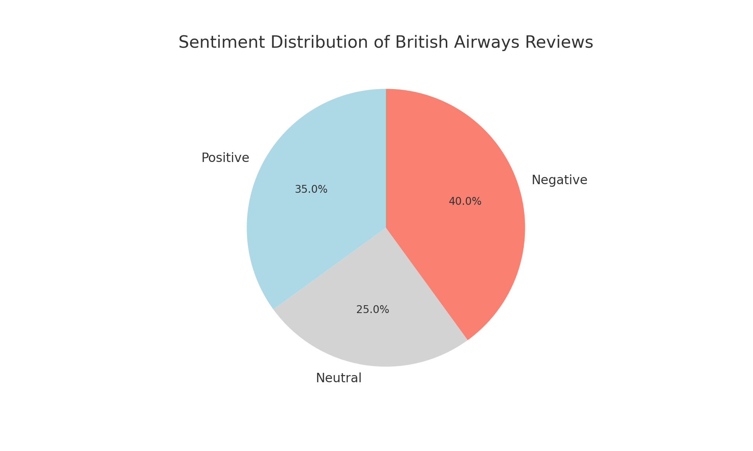
Sentiment Distribution

Slide 7
Sentiment Analysis and Visualization
Include a pie chart or bar chart to show sentiment distribution (e.g., Positive: 35%, Neutral: 25%, Negative: 40%).
WordCloud: Aggregates the cleaned review text into a single string and creates a word cloud to visualize the most common words. This gives an immediate visual of recurring themes and important topics in the reviews.
Matplotlib: Displays the word cloud image.

Slide 8
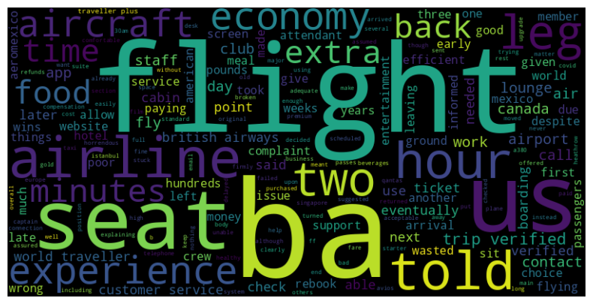
WordCloud Common Terms

Slide 9
Key Takeaways and Recommendations
Mixed Sentiment: Reviews show a balanced mix of positive and negative sentiments.
Positive Aspects: Commonly praised elements include comfortable seating, food quality, and attentive staff.
Negative Aspects: Complaints focus on delays, customer service, and baggage handling issues.
Improve Timeliness: Focus on minimizing flight delays to enhance customer satisfaction.
Enhance Customer Service: Implement training to improve responsiveness and support in challenging situations.
Optimize Baggage Handling: Streamline baggage management to reduce customer frustrations with lost or delayed luggage.

Slide 10
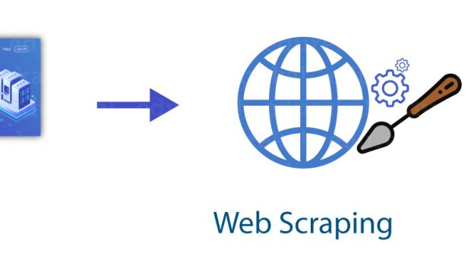
These insights can guide British Airways in prioritizing service improvements based on customer feedback.
GitHub: - https://github.com/revanth-15/British-Airways/blob/main/Task_one.ipynb
Thank You

